Slide 1
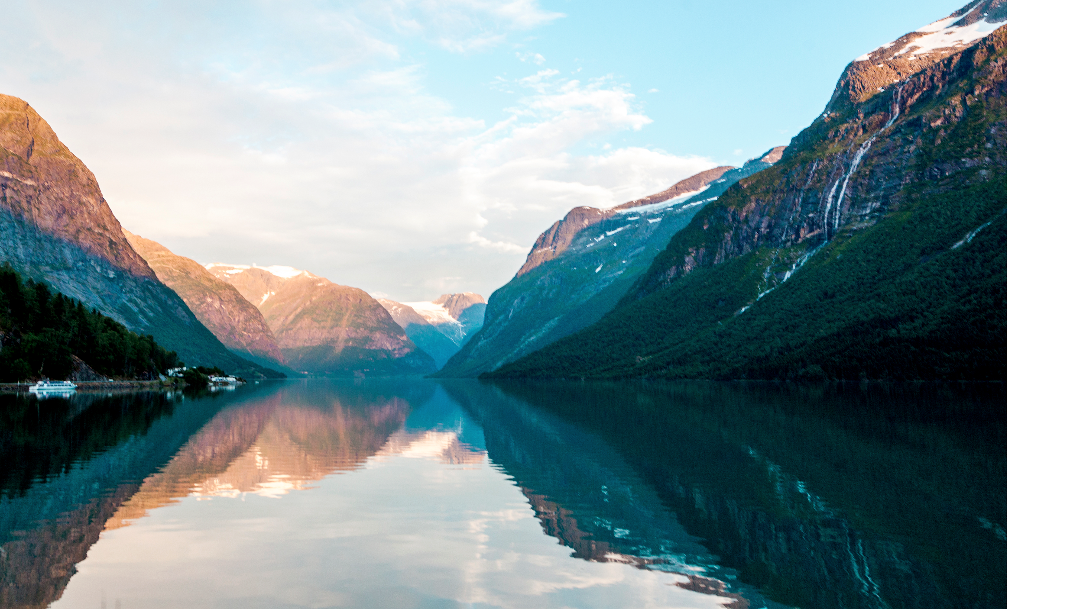

Workplace Stress Level Detection
Wang Hongtao
Yang Yizhou

Slide 2

TABLE OF CONTENTS
01
02
INTRODUCTION
PROPOSED SYSTEM
03
04
IMPLEMENTATION
DETAILS
CONCLUSIONS & FUTURE WORK
Notes:
We will talk about our system from 4 aspects: Introduction, proposed system, implementation details and conclusion & future work.

Slide 3

01
INTRODUCTION
Background:
996, stress is common
Notes:
When we talk about stress, firstly what can we thinking about, we can search in google and found in our society pressure is common , especially in the workplace. You know, 996 is a buzzword which means work from 9am to 9pm for six days. Based on the background, we want to develop a system which can evaluate stress level for each staff.

Slide 4
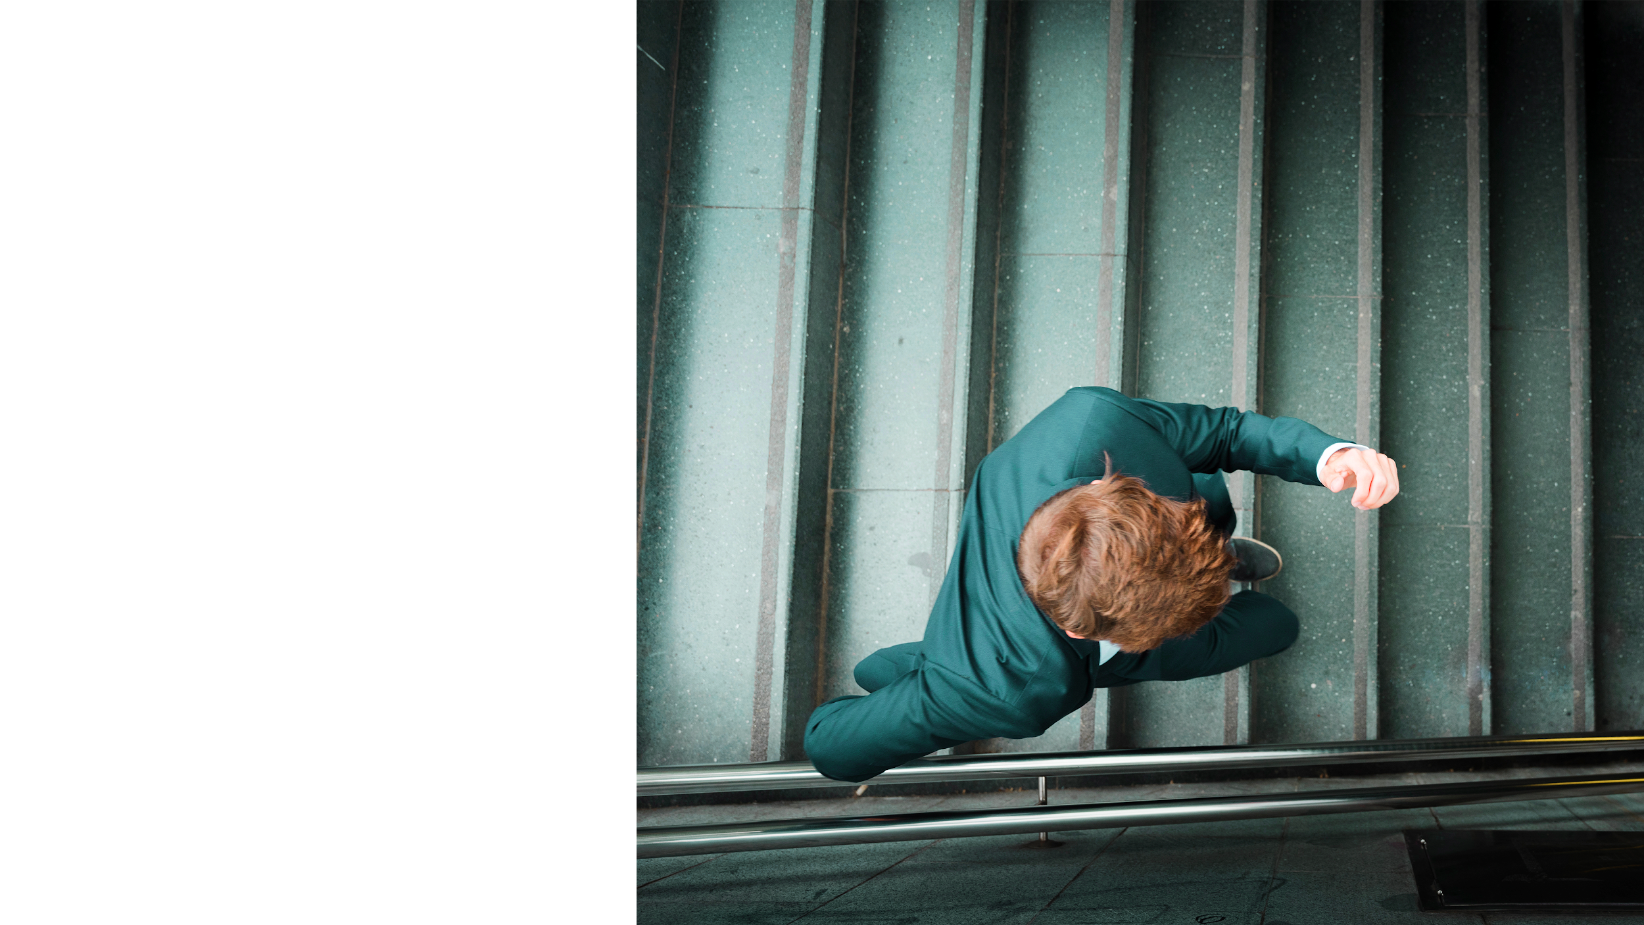

1st ANNOUNCEMENT
Mercury is the closest planet to the Sun and the smallest one in the Solar System—it’s only a bit larger than our Moon. The planet’s name has nothing to do with the liquid metal since it was named after the Roman messenger god, Mercury
Notes:
When we type stress in search bar we found it is very common, so the system can evaluate stress level is important.

Slide 5
Objectives: from emotions to stress level
Generate time seris Emotion
Generate chart to display stress level
Recognize emotions
Reason stress level
Notes:
The purpose of our system is detecting the emotion of employees and using emotion data to reason about employees’ stress level. Finally we can generate a chart to reflect the pressure level of staff for managers and HR.

Slide 6

02
Proposed System
Notes:
For proposed system I will show the demo and describe details for each section

Slide 7
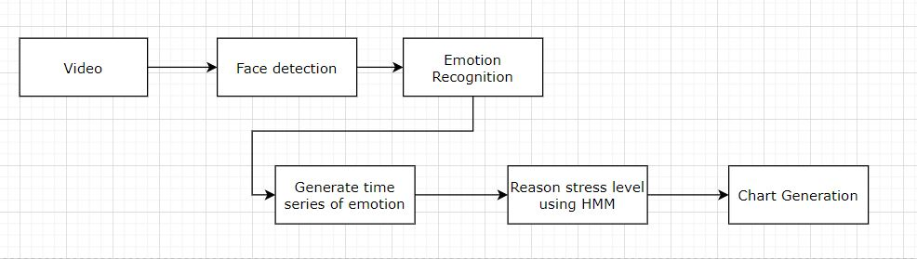
Flow chart
Notes:
We can see our structure of system. Our system is divided into 5 parts: Face detection, Emotion recognition, Generate time series of emotion for each person, Reason stress level using HMM model, Chart Generation. We use one video which have four people as our test video to test each function.

Slide 8
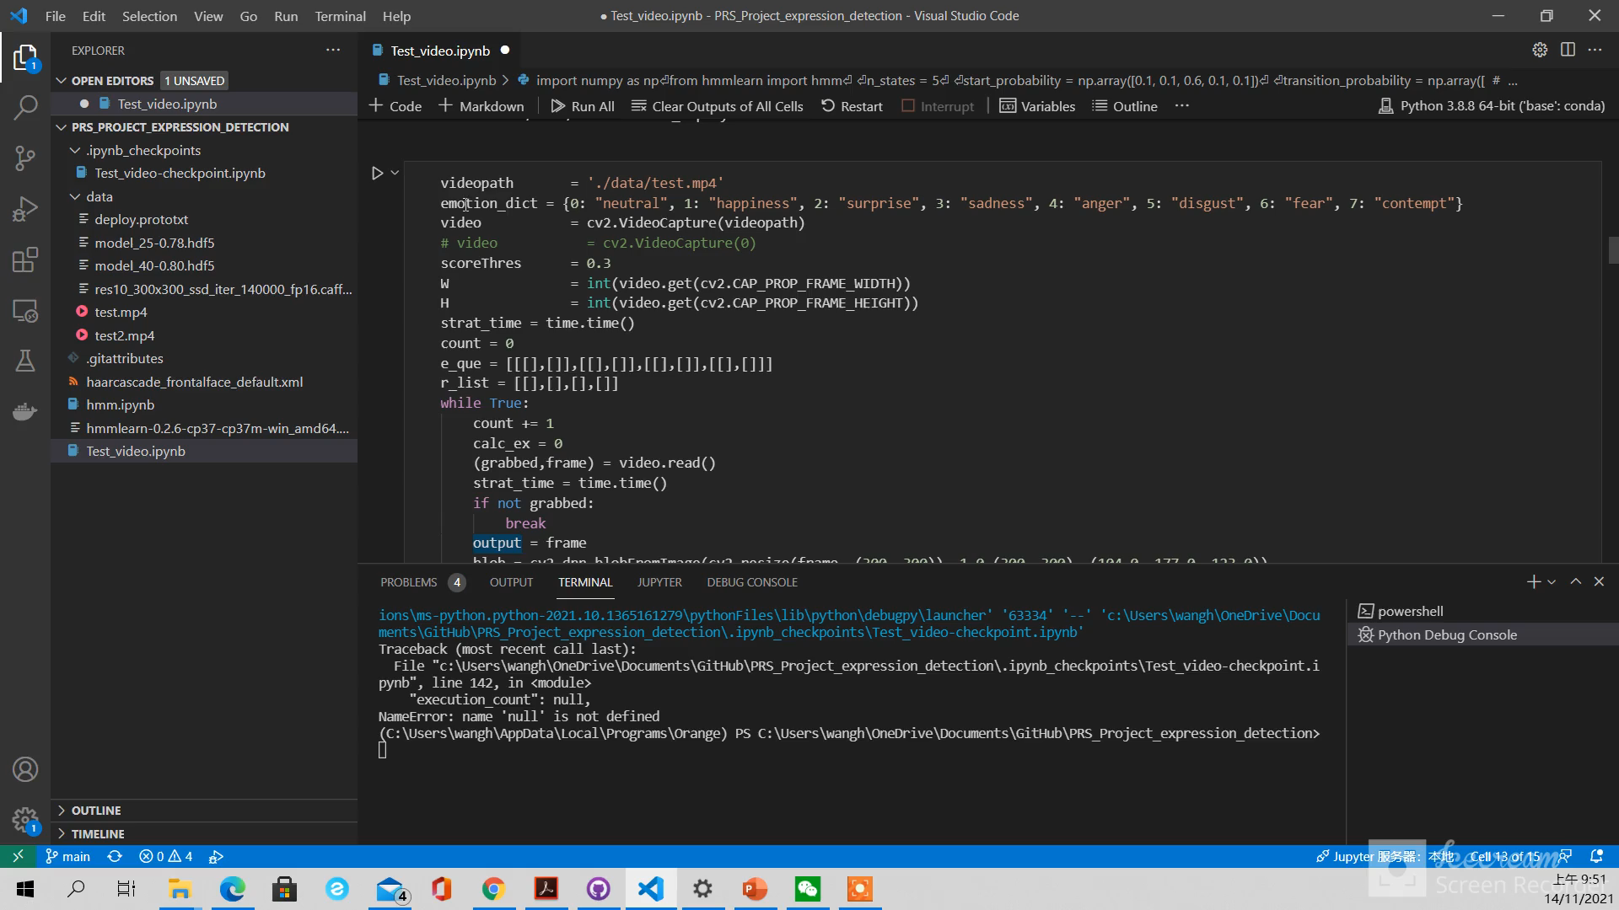

Slide 9
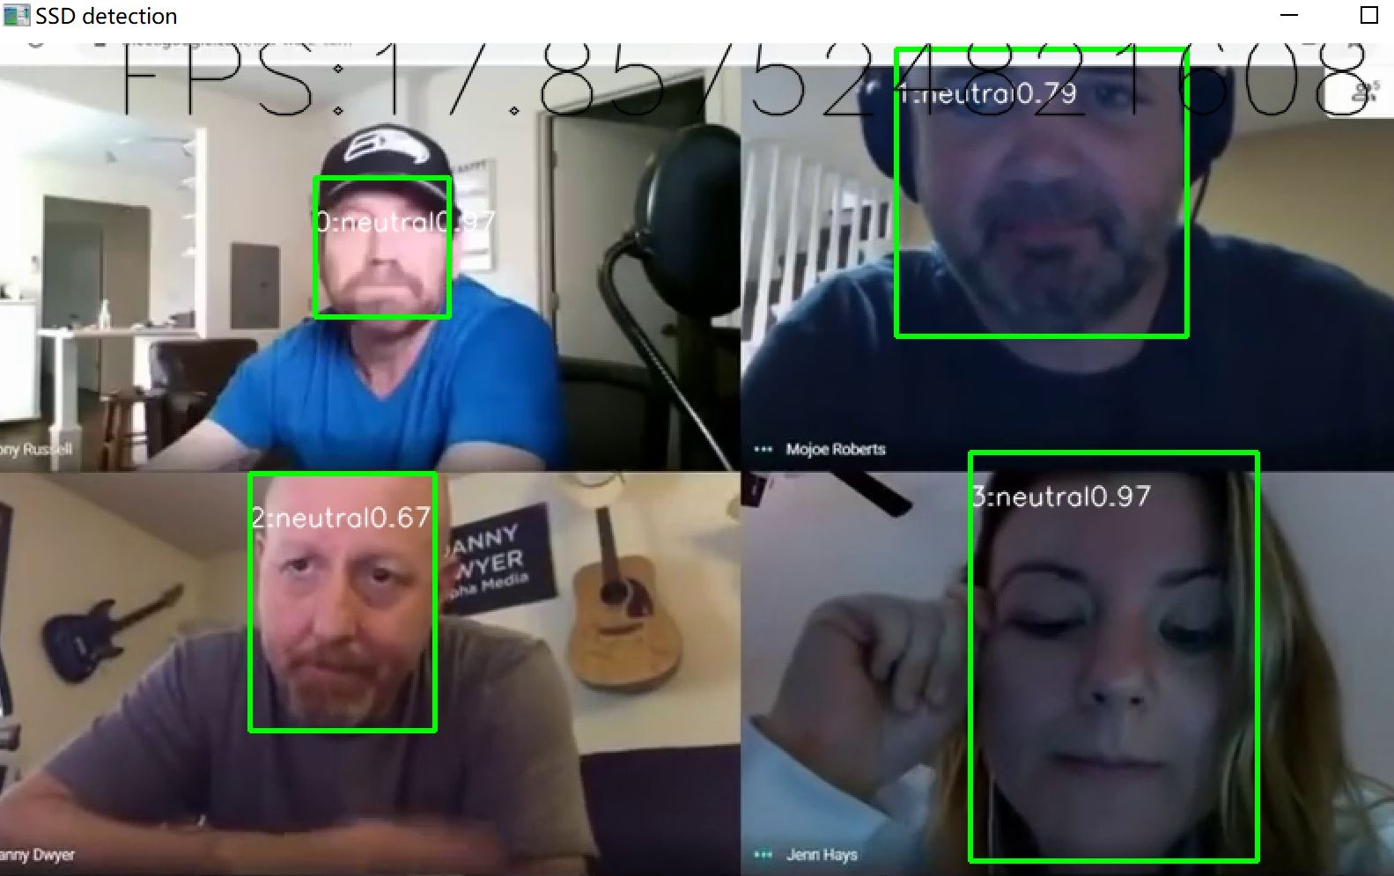
Locate the face and label the face
Face detection
Notes:
We can see from demo video our system firstly detect each person face, then crop the region and label the face from 0-3 because in this video we have 4 person we can detect.

Slide 10
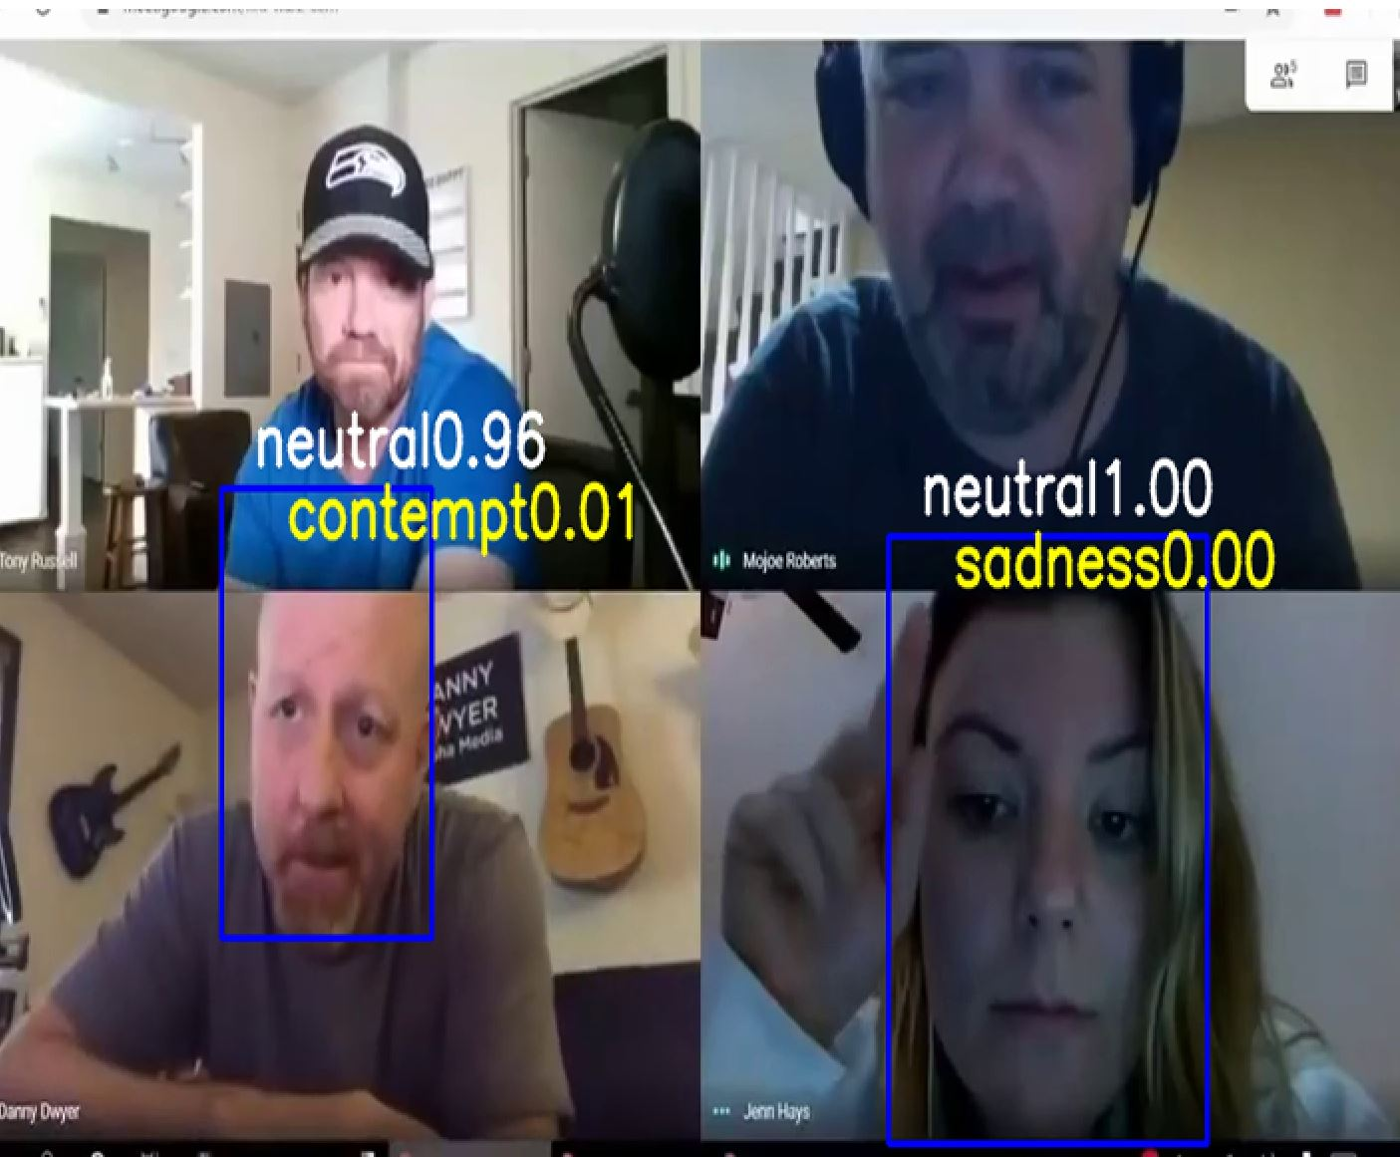
Open CV DNN: Advantages 1) It is suitable for different face orientations: up, down, left, right, side, etc. 2) It can work even under severe occlusion;
Face detection: We compare different approaches, finally use OpenCV DNN
OpenCV Haar-cascade
Advantages: Simple architecture;
Disadvantages 1) There will be a lot of predictions of non-human faces as human faces; 2) Not suitable for non-frontal face images; 3) Not anti-occlusion.

Slide 11
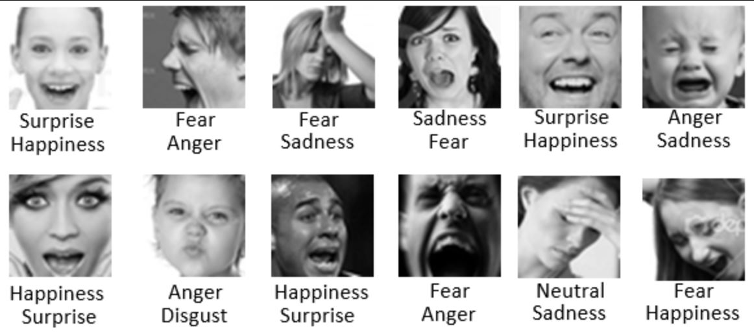
Dataset: FERPlus (Face Expression Recognition Plus dataset) 8 emotion types: neutral, happiness, surprise, sadness, anger, disgust, fear, and contempt.
Emotion recognition
Notes:
The FER+ annotations provide a set of new labels for the standard Emotion FER dataset. In FER+, each image has been labeled by 10 crowd-sourced taggers, which provide better quality ground truth for still image emotion than the original FER labels. Having 10 taggers for each image enables researchers to estimate an emotion probability distribution per face.
In the FER2013 plus dataset, there are a total of eight categories for expressions, which are 'neutral', 'happiness', 'surprise', 'sadness', 'anger', 'disgust', 'fear', 'contempt’.
The FER+ dataset is an extension of the original FER dataset, where the images have been re-labelled into one of 8 emotion types: neutral, happiness, surprise, sadness, anger, disgust, fear, and contempt.

Slide 12
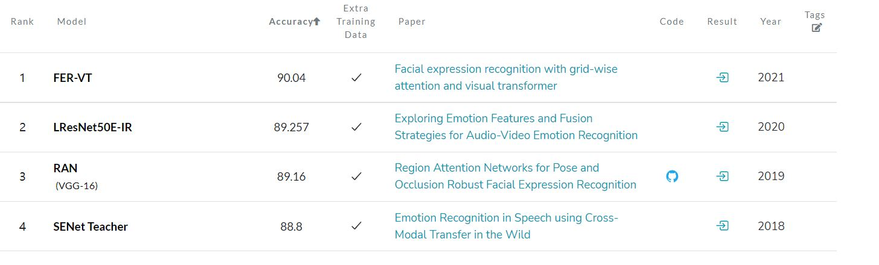
Emotion recognition: Label emotions and show the highest probability
Notes:
We also compare different structure of existing model and learn from them, then train our own model to recognize emotion. The final result is labelling face emotion

Slide 13
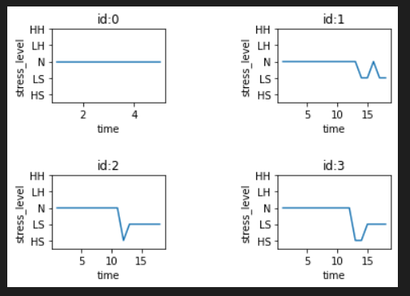
HMM reason stress
stress level = {0: "HS", 1: "LS", 2: "N", 3: "LH", 4: "HH"}
HS: HIGH STRESS LS:LOW STRESS N:NEUTRAL LH:HAPPY
HH:VERY HAPPY
Notes:
IN OUR demo video we run 15 seconds video to collect each person emotion. We can detect 4 person time series emotion , after that using HMM model based on the observation matrix and transition matrix we can reason each person stress. The chart show the result for every staff stress level.

Slide 14
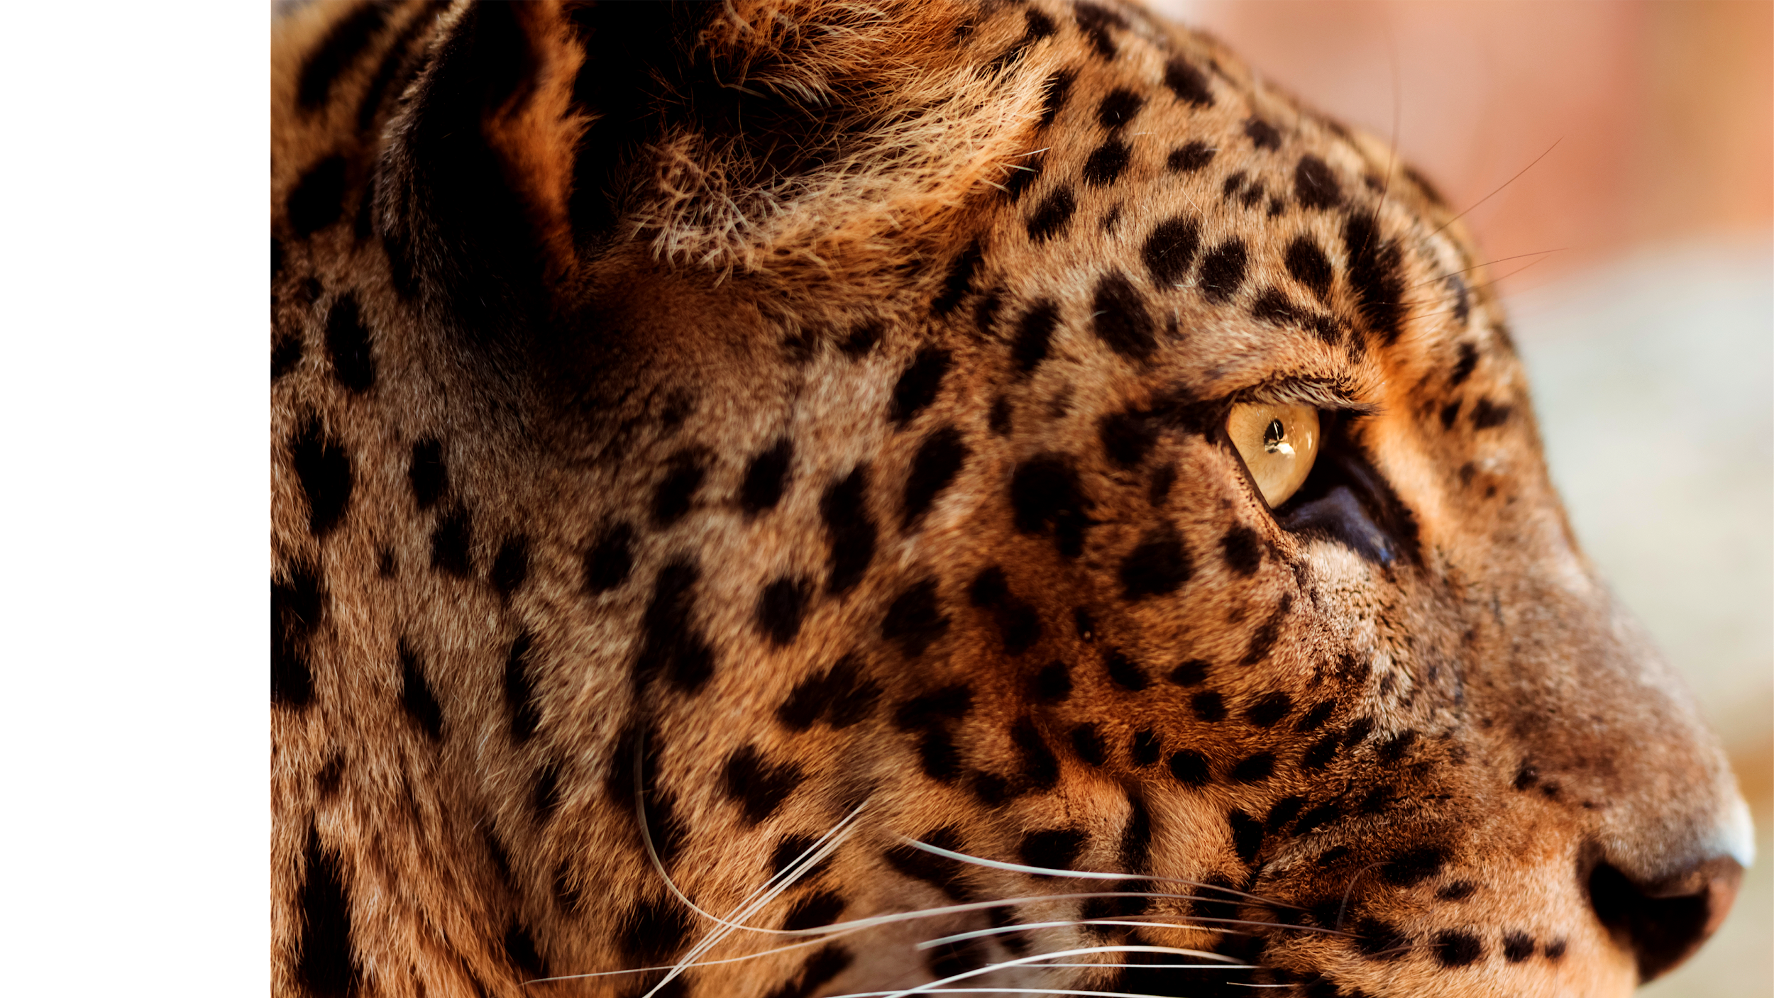
03
IMPLEMENTATION
DETAILS
Notes:
Welcome to the third section, Implementation details

Slide 15



Components
Face Detection
Stress Level Detection
Dataset
Expression Detection
Notes:
The first thing to introduce is the dataset we use, because face recognition uses a model that has already been trained, so here we introduce the dataset for expression recognition

Slide 16
FER2013
Accuracy
FER+
The data consists of 48x48 pixel grayscale images of faces. The faces have been automatically registered so that the face is more or less centered and occupies about the same amount of space in each image. The task is to categorize each face based on the emotion shown in the facial expression in to one of seven categories.
(0=Angry, 1=Disgust, 2=Fear, 3=Happy, 4=Sad, 5=Surprise, 6=Neutral).
The FER+ annotations provide a set of new labels for the standard Emotion FER dataset. In FER+, each image has been labeled by 10 crowd-sourced taggers, which provide better quality ground truth for still image emotion than the original FER labels. Having 10 taggers for each image enables researchers to estimate an emotion probability distribution per face.
80%
60%
FER+
FER2013
Notes:
The FER dataset is the earliest dataset to appear and contains seven expressions containing over 35,000 images.
The FER+ annotations provide a set of new labels for the standard Emotion FER dataset. In FER+, each image has been labeled by 10 crowd-sourced taggers, which provide better quality ground truth for still image emotion than the original FER labels.
With the same model structure and the same parameters and different training sets. We train Two models
The FER2013 dataset can only reach at most 60% accuracy, while FERplus can reach 80% accuracy, which is the reason we chose FERplus.

Slide 17

Components
Dataset
Stress Level Detection
Face Detection
Expression Detection
Notes:
Since the input for expression recognition is a picture of a face, how do we recognise faces? We have also come up with a solution.

Slide 18


Haar cascade classifier
Res10 SSD
Notes:
We have tried two methods, one is the haar cascade classifier and the other is the SSD model. As you can see, using the haar cascade is very ineffective in recognising faces which obscured by other objects, so we chose to use the SSD model to implement face recognition.

Slide 19

Components
Dataset
Expression Detection
Face Detection
Stress Level Detection
Notes:
Now that we have the face image, it's time to detect expressions.

Slide 20
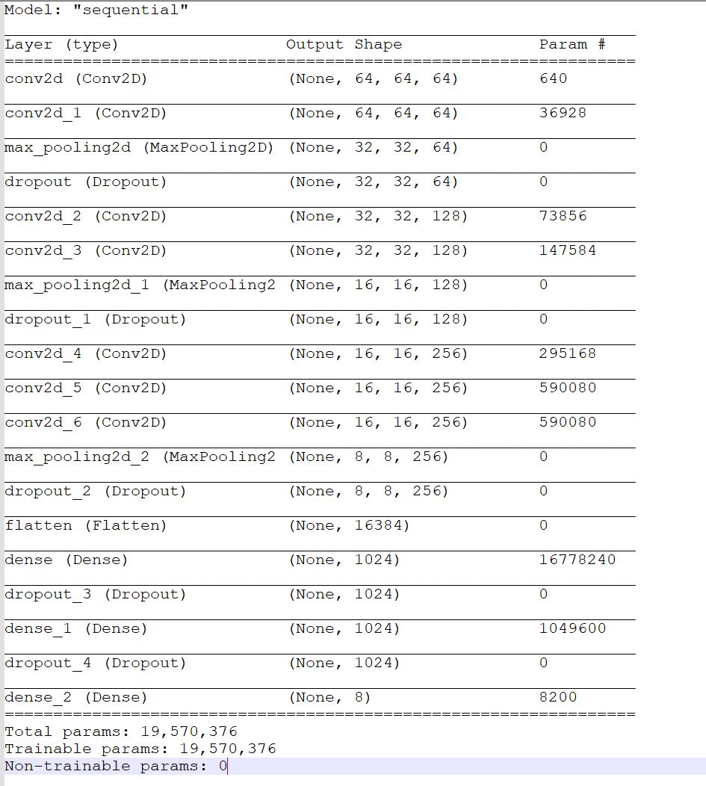
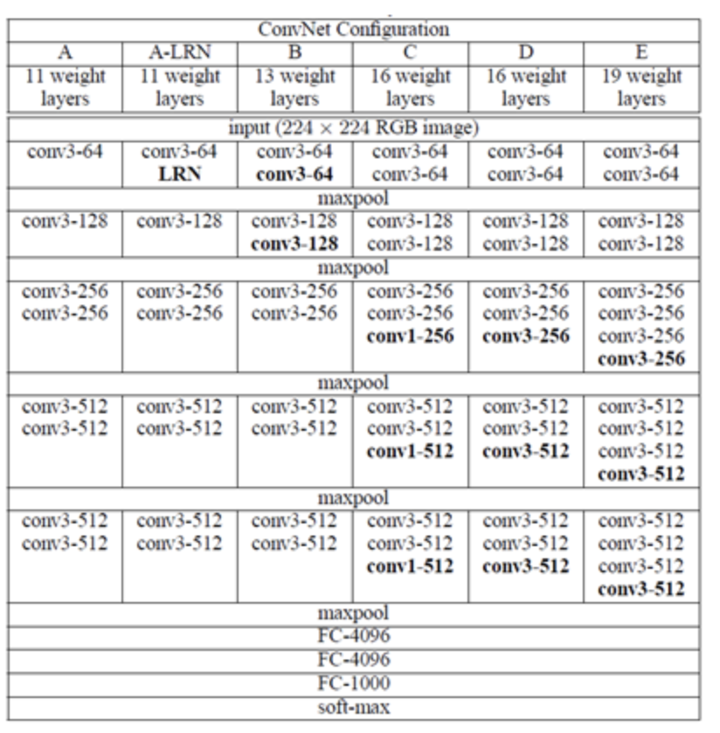
Expression Detection
Overfitting!!
Accuracy = 80.1%
Accuracy = 83.6%
Notes:
We used VGG16 for the backbone net. In the actual training process, we found that VGG 16 overfitted badly for the eight categories, so we made some modifications to the net
We have removed several convolution layers, which reduce the number of parameters substantially. Several dropout layers have been added to improve the generalization ability of the model.
There is an example on Github with a VGG16 implementation, which is 83% accuracy, and our improved net can achieve 80% accuracy, which I think is an acceptable result.

Slide 21
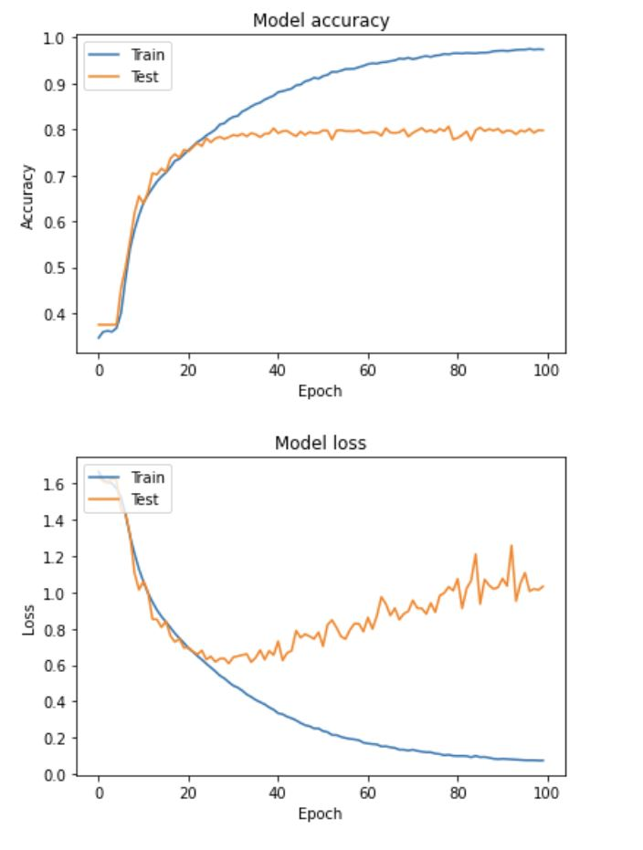
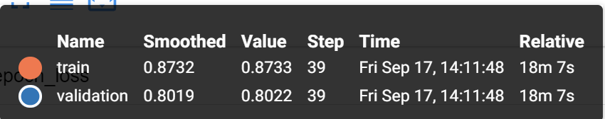
Expression Detection
Pre-processing：
Normalization
One-hot
Hyper-parameters:
Kernel Initializer =‘glorot_uniform'
Input Size = [64, 64, 1]
n_Classes = 8
Optimizer: AdaGrad
Batch Size = 32
Epoch = 100
Loss = 'categorical_crossentropy'
Notes:
On the left is the preprocessing method we used and the hyperparameter settings, and on the right is the history of our model when we trained it.
We can see that the model starts to overfit at 40 epochs, so we take the model at the 39th epoch, which has an accuracy of 80.2% at this time.

Slide 22
Expression Detection
 | neutral | happiness | surprise | sadness | anger | disgust | fear | contempt
neutral | 1099 | 59 | 45 | 157 | 37 | 3 | 11 | 16
happiness | 20 | 788 | 13 | 16 | 17 | 0 | 3 | 0
surprise | 22 | 27 | 361 | 5 | 5 | 2 | 32 | 1
sadness | 88 | 20 | 4 | 233 | 10 | 1 | 8 | 4
anger | 41 | 33 | 17 | 30 | 251 | 11 | 9 | 6
disgust | 0 | 0 | 0 | 2 | 1 | 4 | 0 | 1
fear | 4 | 2 | 10 | 6 | 1 | 0 | 35 | 0
contempt | 0 | 0 | 0 | 0 | 0 | 0 | 0 | 2
Notes:
As you can see from this confusion matrix, the overall performance is OK. However, there are some expressions that indicate more stress that may be recognised incorrectly, such as neutral and sadness.

Slide 23

Components
Dataset
Stress Level Detection
Face Detection
Expression Detection
Notes:
Now we have the expressions, how do we get the person's stress level?

Slide 24
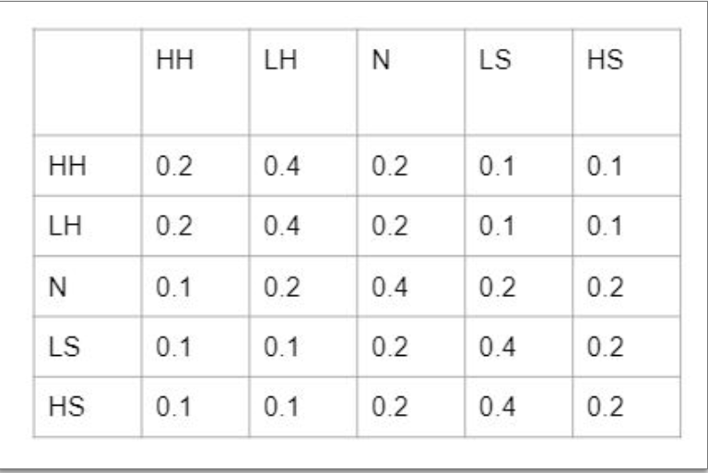
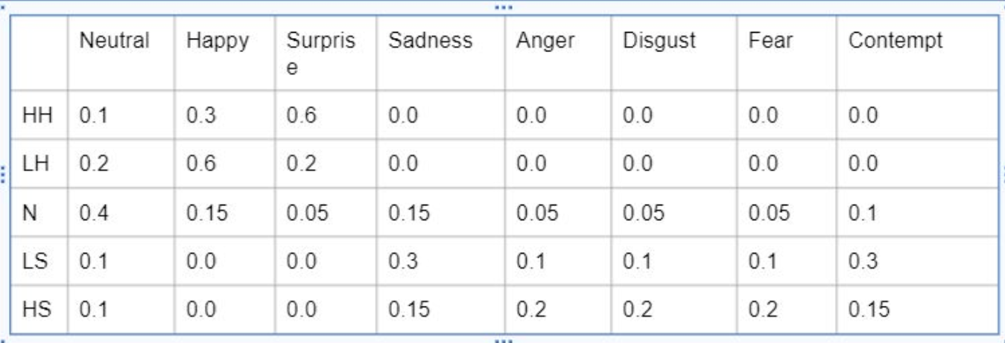
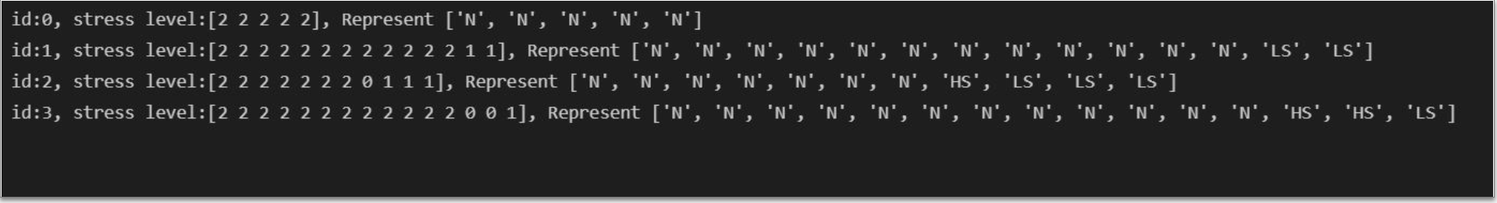
Stress Level Detection
HH: High Happness
LH: Low Happness
N: Normal
LS: Low Stress
HS: High Stress
Transition Matrix
Observation
Notes:
We use HMM to reason stress level for each person.
Observation is the expression of the person and hidden state is the stress level of the person.When we know the observation matrix and the transition matrix, with the HMM, we can easily get the stress level of the person. It is as shown in the diagram.
Note that since we do not have a corresponding dataset, the two matrices are defined by us.

Slide 25

04
Future Work
Notes:
These are the details of our implementation. Now introducing the areas that can be enhanced in the future.

Slide 26

Question
What is this expression?
"Fear", "Anger" or "Surprise"?
Notes:
First let me ask a question
What is this expression?
. "Fear", "Anger" or "Surprise"?
I can't give an answer if it's just a picture.

Slide 27

From expression to emotion
Expression recognition
In our application, we took a video of a time period and predicted all the expressions in that time period and then chose the expressions that appeared the most to represent that time period. Although this method improves the performance of the recognition, it does not essentially solve the problem.
In the future it may be possible to incorporate a variety of judgement criteria, such as voice, the reaction of those around you, atmosphere and other factors to predict expressions in combination.
In terms of our everyday experience, it can be difficult to spot a person's emotions, especially in public. People are very good at hiding their emotions in public. So deducing the person's emotions just by their expressions is actually very difficult. In the future, if we want to increase the accuracy rate, we may seek the help of some psychologists so that we can look for the characteristics of human emotions, not only expressions but also possibly actions, tone of voice, reactions, etc.
Notes:
So here are two points that could be enhanced in the future.
first
Our system provides an effective way to recognise expressions, but does not perform well with some hard to detect expressions
In the future it may be possible to incorporate a variety of judgement criteria, such as voice, the reaction of those around you, atmosphere and other factors to predict expressions in combination
Second
People are very good at hiding their emotions in public. So deducing the person's emotions just by their expressions is actually very difficult. In the future, if we want to increase the accuracy rate, we may seek the help of some psychologists so that we can look for the characteristics of human emotions, not only expressions but also possibly actions, tone of voice, reactions, etc.

Slide 28
Thank you for listening！
PHOTOS & Video
All images are from the internet.

